Slide 1
GIT for beginners
Tracking and collaboration

Slide 2
Background
Version control
Collaboration with others and accessibility
How GIT approaches version control

Slide 3
Downloading
Follow the standard download instructions
https://git-scm.com/download/win
https://git-scm.com/download/mac

Slide 4
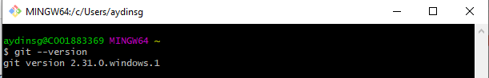
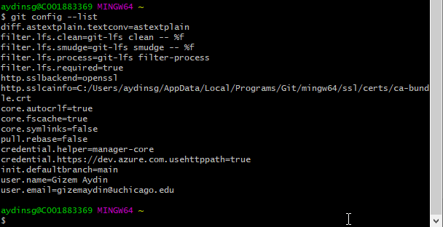
Setting global username and email
Checking all configuration

Slide 5
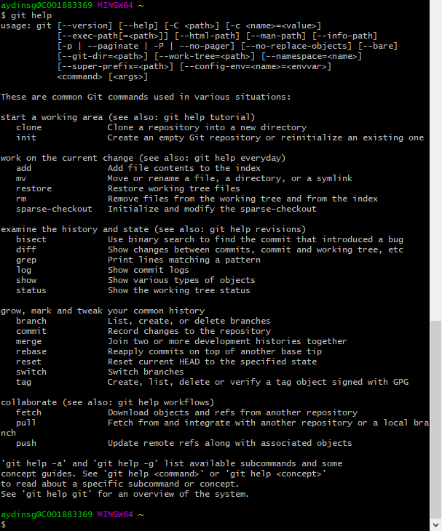
Git help

Slide 6
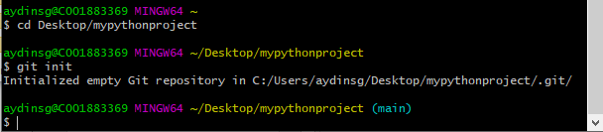
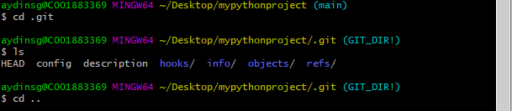

Initialize a new git repository
Repo = Virtual storage for your project! Each project in GIT is
Step 1: go to the folder you’d like to track (cd desktop/mypythonproject)
Step 2: initialize a git repo by running the “git init” command
Notes:
To create a folder mkdir newFolderName

Slide 7
Collaboration and Contribution
GIT Repo Hosting Services: GitHub, GitLab, BitBucket
Access anytime anywhere, and collaborate with others

Slide 8
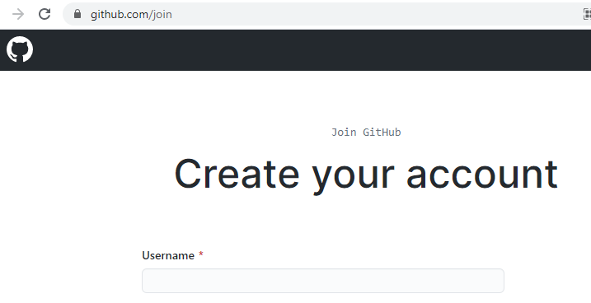
Creating an account
https://github.com/join
Email verification, and done!

Slide 9
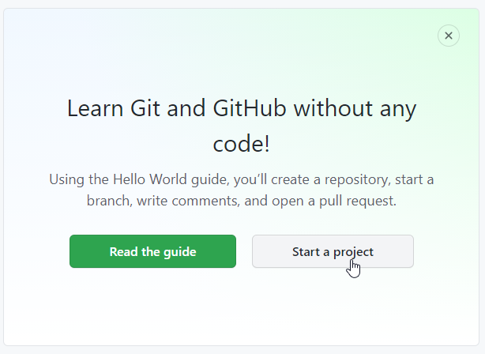

Slide 10
Create a new repo on the command line
echo “# AydinGizem” >>README.md
git init
git add README.md
git commit –m “first commit”
git remote add origin https://github.com/AydinGizem/teaching-git-hub.git
git push –u origin main
Import code from another repo
xxxx
Push an existing repo from the command line
git remote add origin https://github.com/AydinGizem/teaching-git-hub.git
git push –u origin main

